Slide 1
BTECH 451 PROJECT
Compucon - Epiphany Project
Mong-Fan Wang

Slide 2
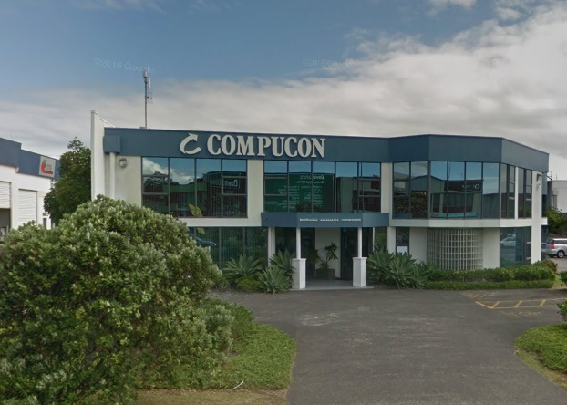
COMPUCON
Established in 1992
Computing system manufacturer
Provides businesses with Workstations/Servers

Slide 3
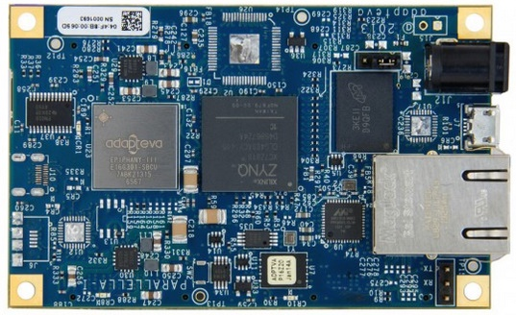
PARALLELLA EPIPHANY
Main focus of the project
Specs:
Credit-card sized computer
16 cores
Gigabit Ethernet
1 GB SDRAM
Parallel processing
Flexibility & Scalability
Extremely low TDP – 5W

Slide 4
PROJECT GOALS
Background understanding of Epiphany Parallella
Research OpenCL and threaded MPI computing
Hands-on demo with the Epiphany Parallella
Learn MPI (Message Passing Interface) for clustering
Learn BSP (Bulk synchronous parallel)

Slide 5
LEARNING GOALS
Understand in depth the Epiphany co-processor
Be able to program the Parallella
Gain knowledge in parallel computing
Find new scenarios to utilise this small computer

Slide 6
Progress / Agenda
Fully set up Parallella Epiphany Environment
Run Linux Ubuntu on the device (With & Without Display)
Research into multiple different frameworks/tools available
COPRTHR, OpenCL, MPI, Threaded MPI, BSP
Cross Compilation
Clustering
Create application

Slide 7
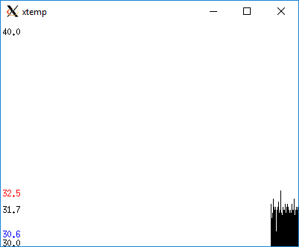
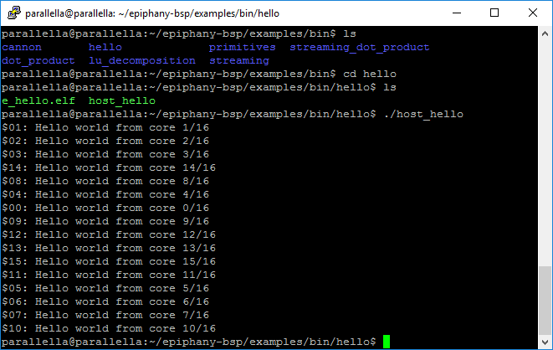
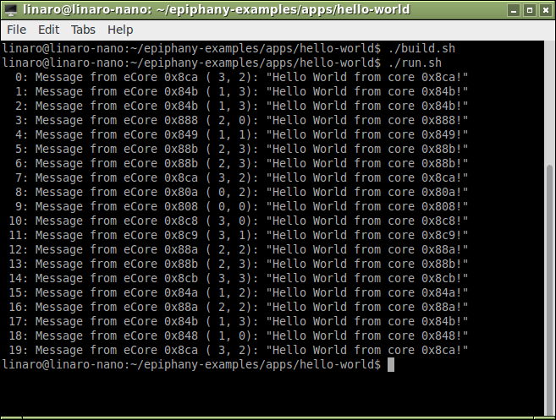
Demo Applications

